Slide 1
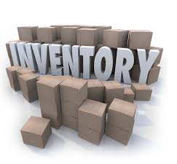

IS 436 Deliverable 4 & 5: Retail Inventory System
Leader Justin Chan
QA Parmeet Dua
Programmer Brandon Nguyen
Analyst Urgy Eado
QA Support Jaime Pineda
Project Manager Rafay Khurram
Editor Raj Desai

Slide 2
Deliverable 4

Slide 3
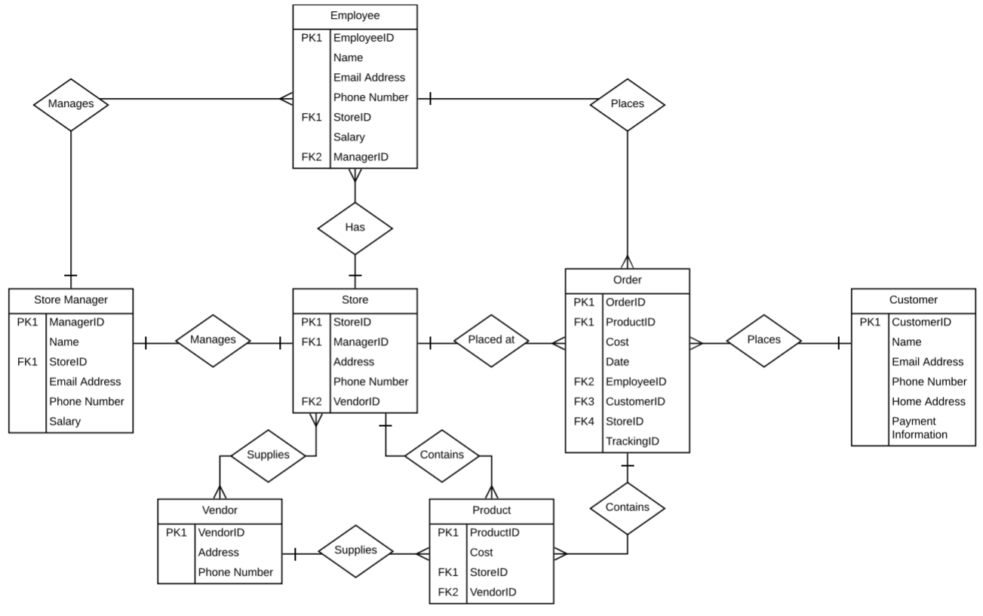
Entity Relationship Diagram

Slide 4
Text Definitions - Order
This is where the order is placed with all the required attributes.
This table will take in all the info necessary to complete an order.
To show were the order is supposed to be placed, the order table is connected to store through its primary key ‘orderID’, which makes it unique from other orders.
Date is required in order to show the time period the order was placed. All the other attributes are placed as a foreign key and all those foreign keys carry their own values.

Slide 5
Text Definitions - Product
This is the material being purchased, this material has a productID to be unique from other products, whenever order has been made, productID is placed into the order as a foreign key to complete the order. It also has another attribute, which shows the cost of the product.

Slide 6
Text Definitions - Customer
This entity carries all the customer info, and its connected to the order through its primary key which is the customerID.
The rest of its attributes are description of the customer name and phone number just in case the customer needs to be contacted.
Customers can have multiple orders.

Slide 7
Text Definitions - Vendor
Vendors contain attributes that include vendorID, address, and Phone number.
These attributes are necessary for maintaining purchases and general management.
Vendors are identified by vendorID and can be joined to the store and product tables by vendorID foreign keys.

Slide 8
Text Definitions - Employee
The identifier of employee is employee ID which is of type number.
The employee entity can be joined with the store through the EmployeeID PK in store.
There's name, email address and phone number which are all of the varchar2 type and are necessary for employee and database management.

Slide 9
Text Definitions - Stores
Stores are one of the most important entities because its numerous connections to other entities.
If the company expands then Stores are identified by their ID. Stores can have numerous products, employees, and orders. Stores are managed by a single manager.

Slide 10
Text Definitions - Manager
The managers table is identified by the ManagerID attribute. It contains other attributes such as Name, StoreID, Email address, Phone number, and Salary. There is one manager to each store. There’s also one manager to each employee.

Slide 11
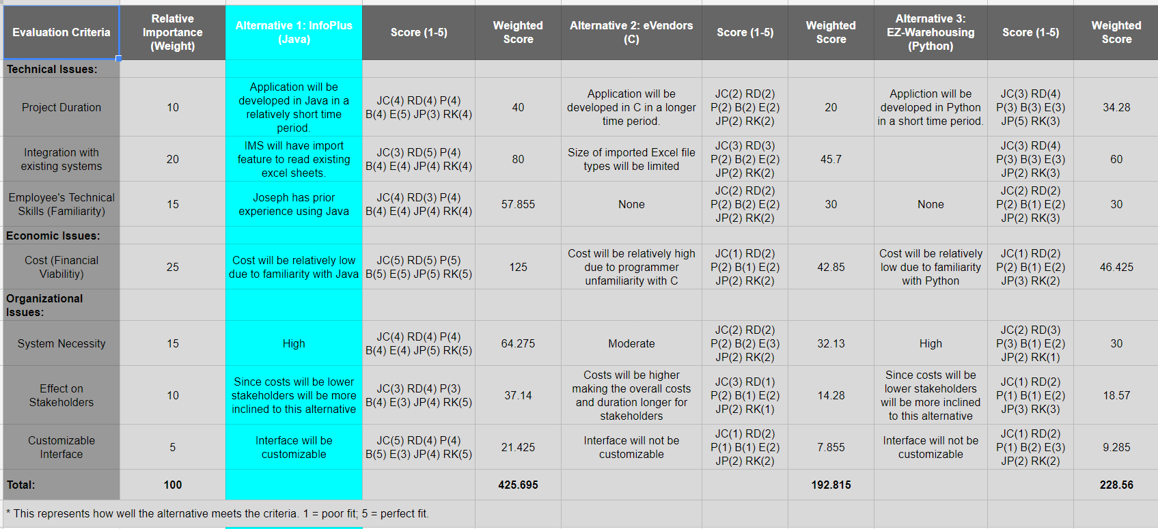
Alternative Matrix
https://docs.google.com/spreadsheets/d/1-EPzKDxclSSctxHr0MDlIYwhXb9vgm5yh-vxRsQmgkU/edit?usp=sharing

Slide 12
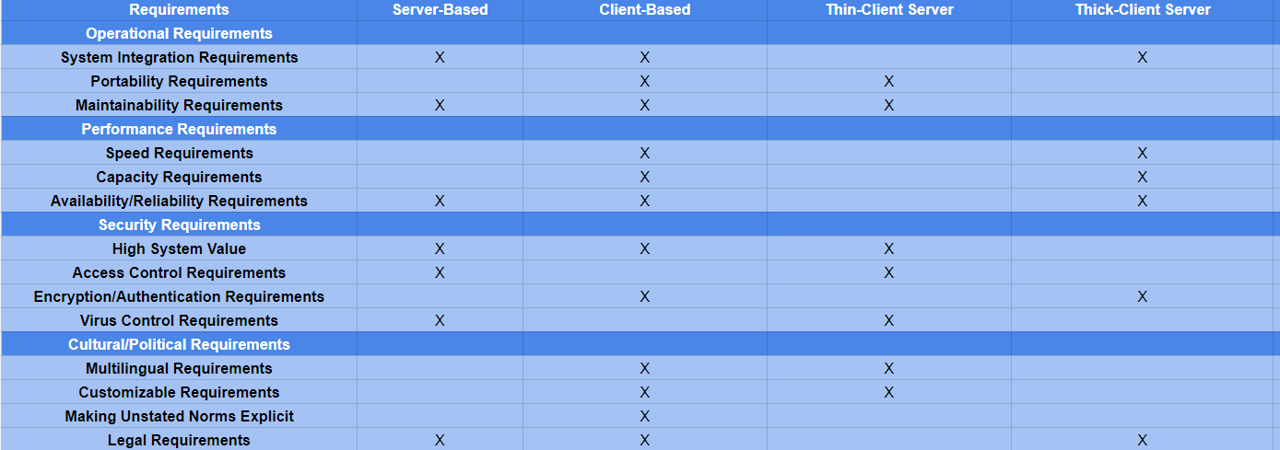
Architecture Matrix
https://docs.google.com/spreadsheets/d/1RhZ60NRJbxjVbpfr144h-DvpCP2YwO_YlplzQ8v19ew/edit?usp=sharing

Slide 13
Non-Functional Requirements - Operational
Requirements | Definition | Examples
Technical Environment | The IMS software, and network requirements should follow the business requirements | All IMS’s have always-on network connection permitting real-time database updates
System Integration | The extent to which the system will operate with other systems The extent the IMS will work with existing systems. (i.e. Database) | The system will read and modify existing documentation used for keeping inventory.
Portability | The extent to which the system IMS will accessible on various different devices. | We will launch a mobile application to able to access the IMS in the near future.
Maintainability | The IMS should be able to adapt modifications from all users. | The IMS system will reflect changes immediately

Slide 14
Non-Functional Requirements - Performance
Requirements | Definition | Examples
Speed | Time within which the IMS system must perform its function | The IMS update response time <= 2.5 seconds
Capacity | Total and peak number of users and the volume of data expected | Maximum of 500 simultaneous users at peak use times
Availability and Reliability | Extent to which the IMS system will be accessible to the users and the allowable failure rate due to faults | 99% uptime performance

Slide 15
Non-Functional Requirements - Security
Requirements | Definition | Examples
System Value Estimates | Estimated business value of the system and its data | A complete loss of all system data would equate to $5 million.
Access Control | Limitations on which can access what data | Manager will have full access to the IMS whereas employee has limited access.
Encryption and Authentication | Defines what data will be encrypted where and whether authentication will be needed for user access | Some users need to be authenticated by the manager.
Virus Control | Controls to limit viruses | There is a low probability of uploading outside files to the IMS.
Notes:
5 milli

Slide 16
Non-Functional Requirements – Cultural/Political
Requirements | Definition | Examples
Multilingual | The language(s) the system users will need | The system will operate in English, Spanish
Customization | Specification of what aspects of the system can be changed by local users | Managers will have access to update the user interface of the IMS to reflect their business
Legal | The laws and regulations that impose system requirements | Personal customer information cannot be distributed to third parties

Slide 17
Deliverable 5

Slide 18
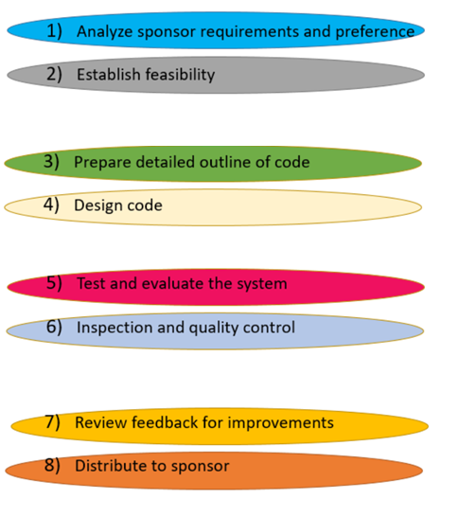
Work Plan
Start Date | End Date | Current Status
3/1 | 3/7 | COMPLETE
3/7 | 3/12 | COMPLETE
3/13 | 3/28 | COMPLETE
3/28 | 4/15 | COMPLETE
4/15 | 4/29 | COMPLETE
4/29 | 5/2 | COMPLETE
5/2 | 5/12 | COMPLETE
5/12 | 5/20 | UPCOMING
Sprint 1
Sprint 2
Sprint 3
Sprint 4

Slide 19
Kanbanflow
https://kanbanflow.com/board/9a8db723b7a3ce9bfbacb5e7b322b4f3

Slide 20
Experiences with SDLC
Rewards
Challenges faced
Solution to challenges

Slide 21
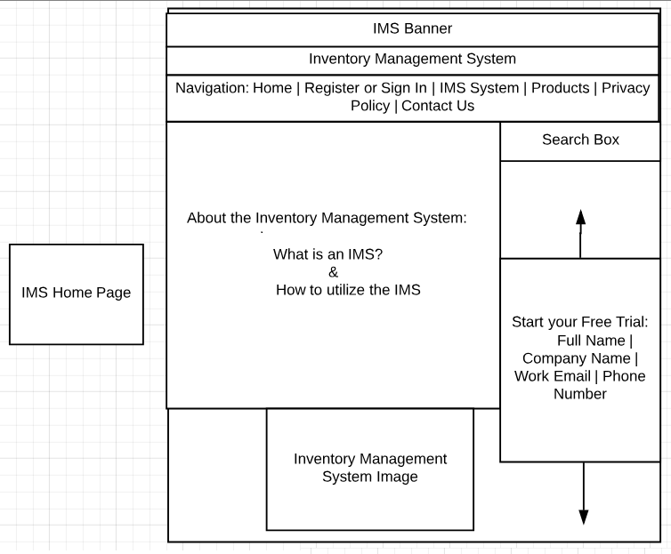
Wireframe Diagram – Home Page

Slide 22
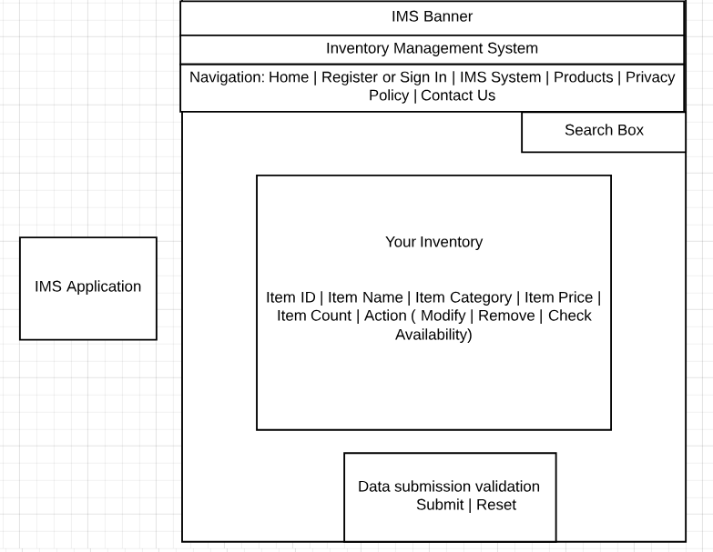
Wireframe Diagram – IMS Application

Slide 23
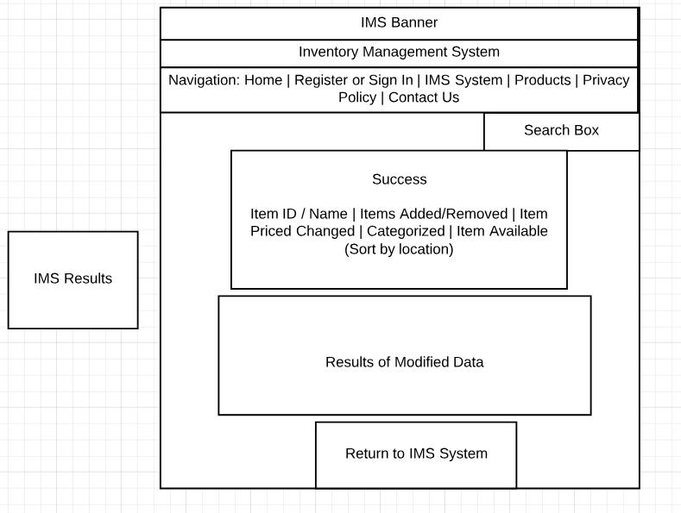
Wireframe Diagram – IMS Results

Slide 24
Link to application
https://swe.umbc.edu/~juschan1/436/Project/HomePage.html
https://github.com/JusChan1/Deliverable1 - Github (IMSHomePage.html || IMSPage.html || IMSResults.html)
http://htmlpreview.github.io/?https://github.com/JusChan1/Deliverable1/blob/master/IMSHomePage.html

